Slide 1
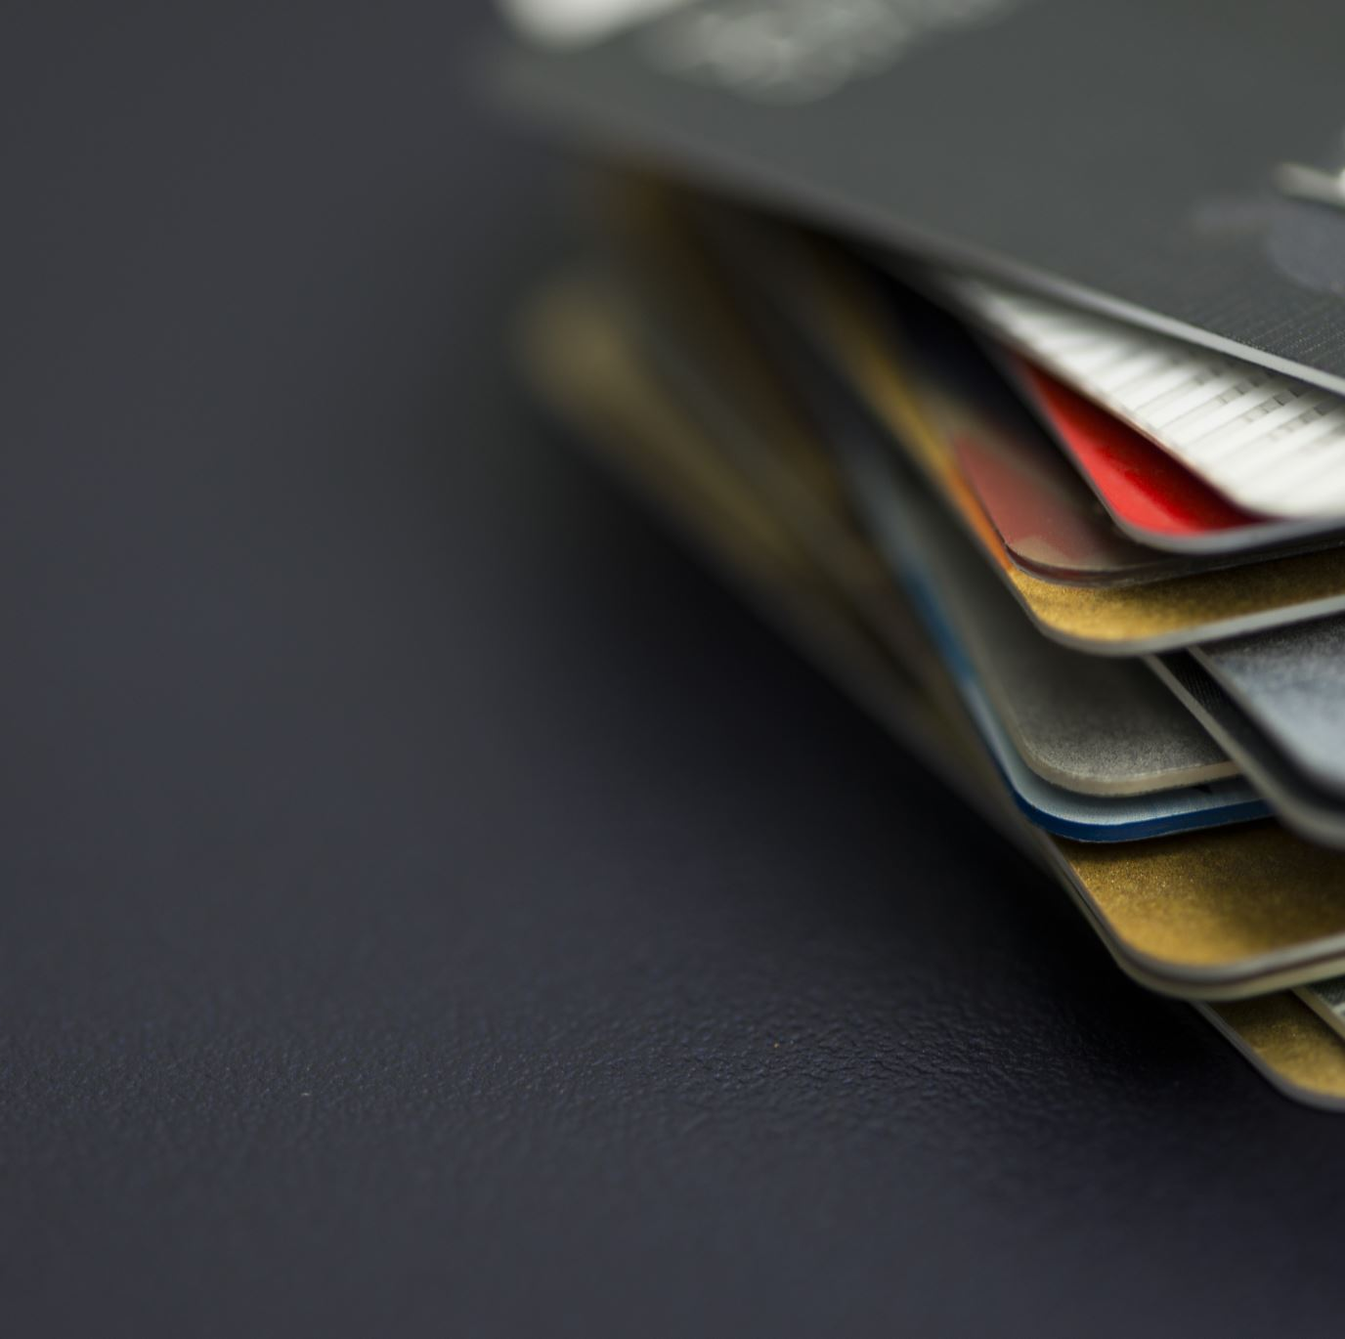
Credit Card Transactions Fraud Detection
Group 5
Hemanth (14411094 )
Bindu ( 16338568 )
Teja ( 16336900 )

Slide 2
Introduction
Our objective is to develop an advanced system to detect and prevent credit card fraud, ensuring peace of mind for cardholders.
Why It Matters:
Credit card fraud poses a significant threat to individuals and financial institutions, causing substantial losses each year.
Credit Card Fraud Statistics (2023)
46% of global credit card fraud happens in the US
Credit card fraud worldwide will reach $43 billion by 2026
US credit card fraud losses will eclipse $12.5 billion by 2025
48% of consumers say it’s the merchant’s responsibility to protect them from fraud
55% of fraudulent credit and debit card transactions are less than $100
Every 14 seconds, a person in the US falls victim to identity theft

Slide 3

Dataset: https://www.kaggle.com/datasets/kartik2112/fraud-detection
Name : Credit Card Fraud Transaction detection
Dimension : 1.3 million * 23
Data Size : 502 MB
No of Columns : 23
Columns : Trans date, CC_Num, Merchant, Category, Amt, Gender, Name ,City, State, Zip, Job etc.
Date: 1 Jan 2019 to 31 Dec 2020.

Slide 4
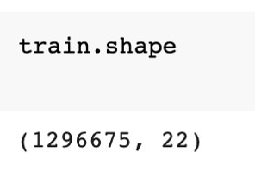
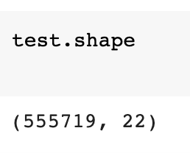
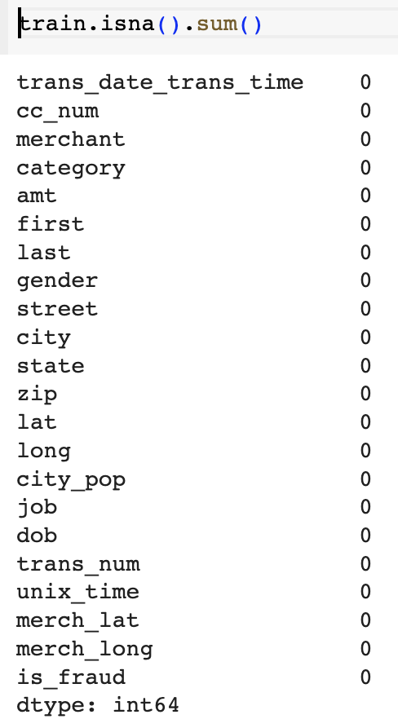
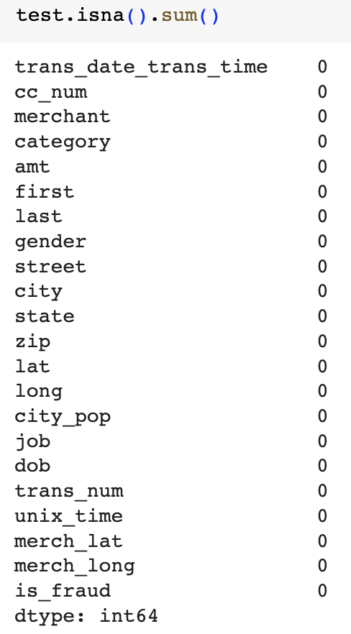
Exploratory Data Analysis
Data Cleaning
Univariate Analysis
Bivariate Analysis
Data Visualization
Summary Statistics
Outlier Detection

Slide 5
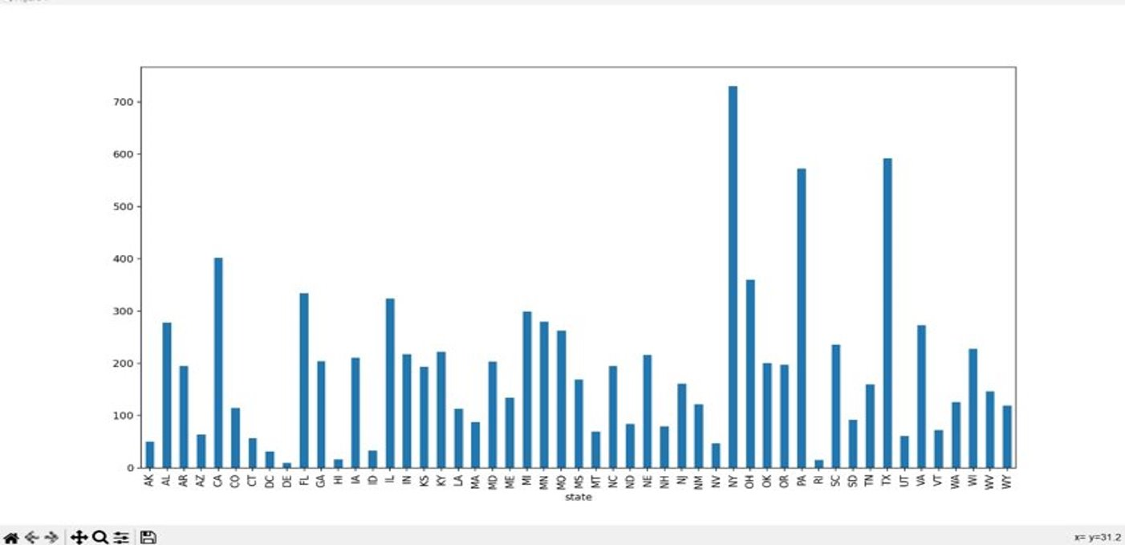
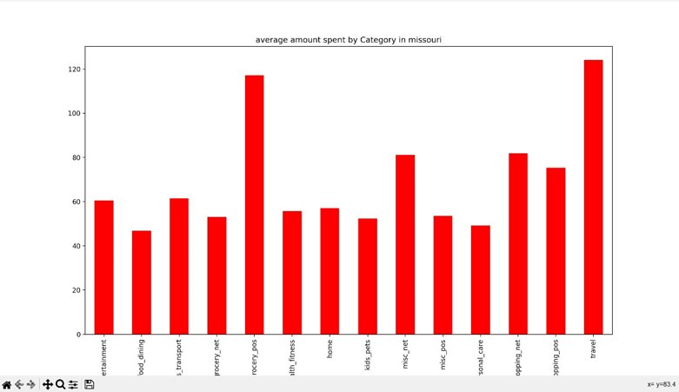
Preliminary Analysis
New York has highest recorded fraud transactions followed by Texas and Pennsylvania.
The number of fraud transactions is high for age group 50-60.
More number of fraud transactions were recorded at entertainment and grocery merchants.
In Missouri, travel is the most spent category followed by grocery.

Slide 6
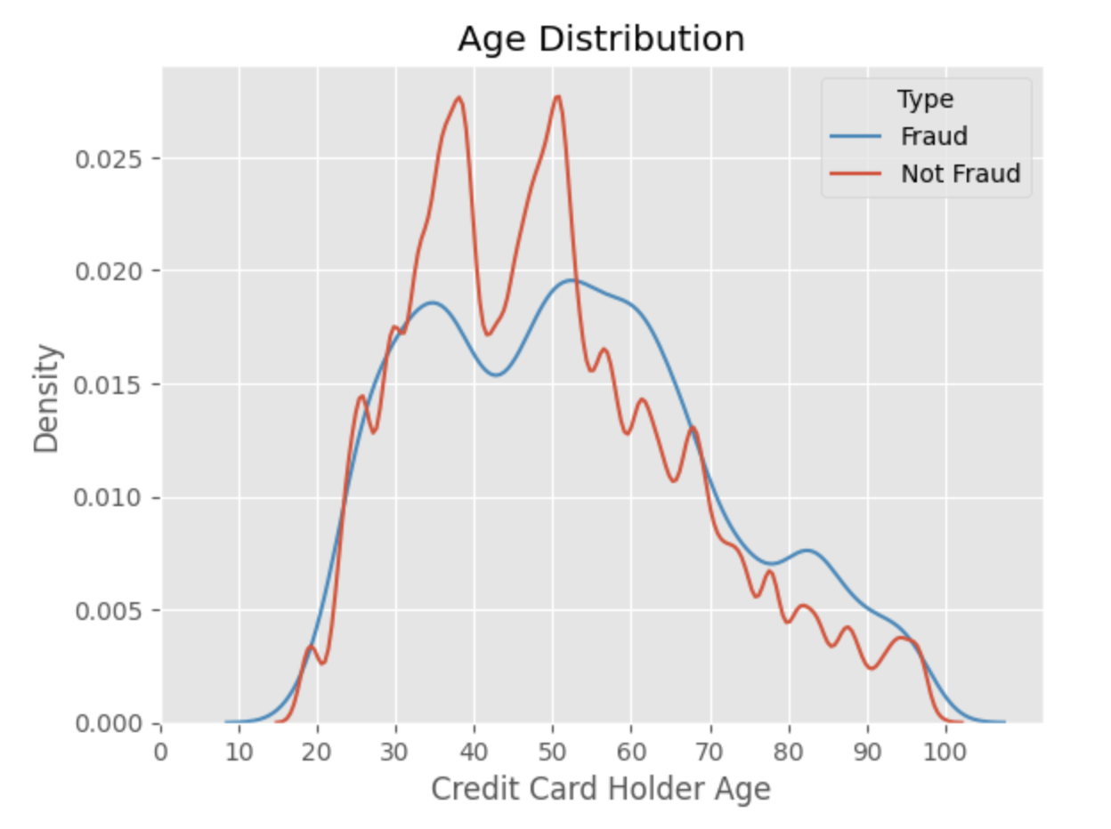
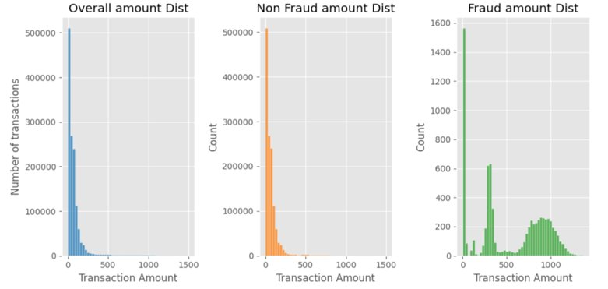
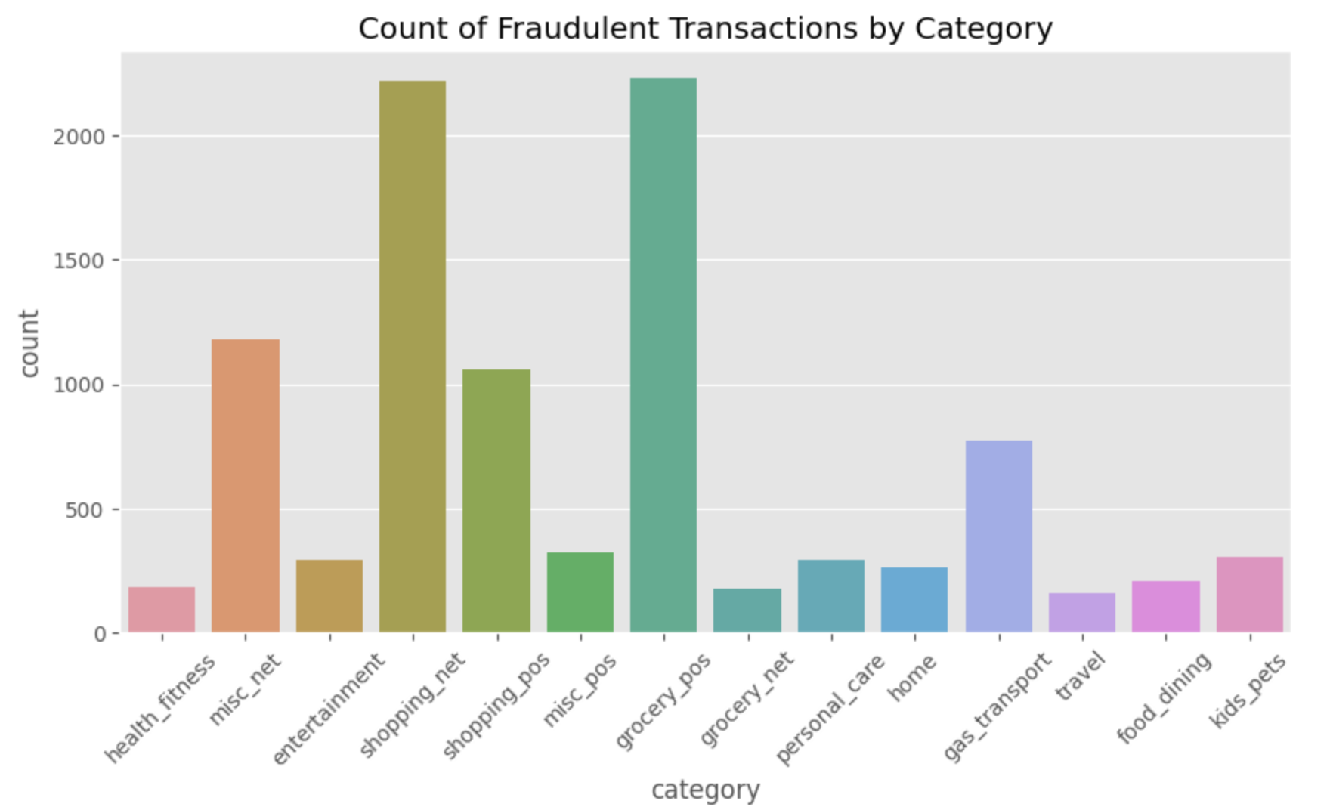
Preliminary Analysis

Slide 7
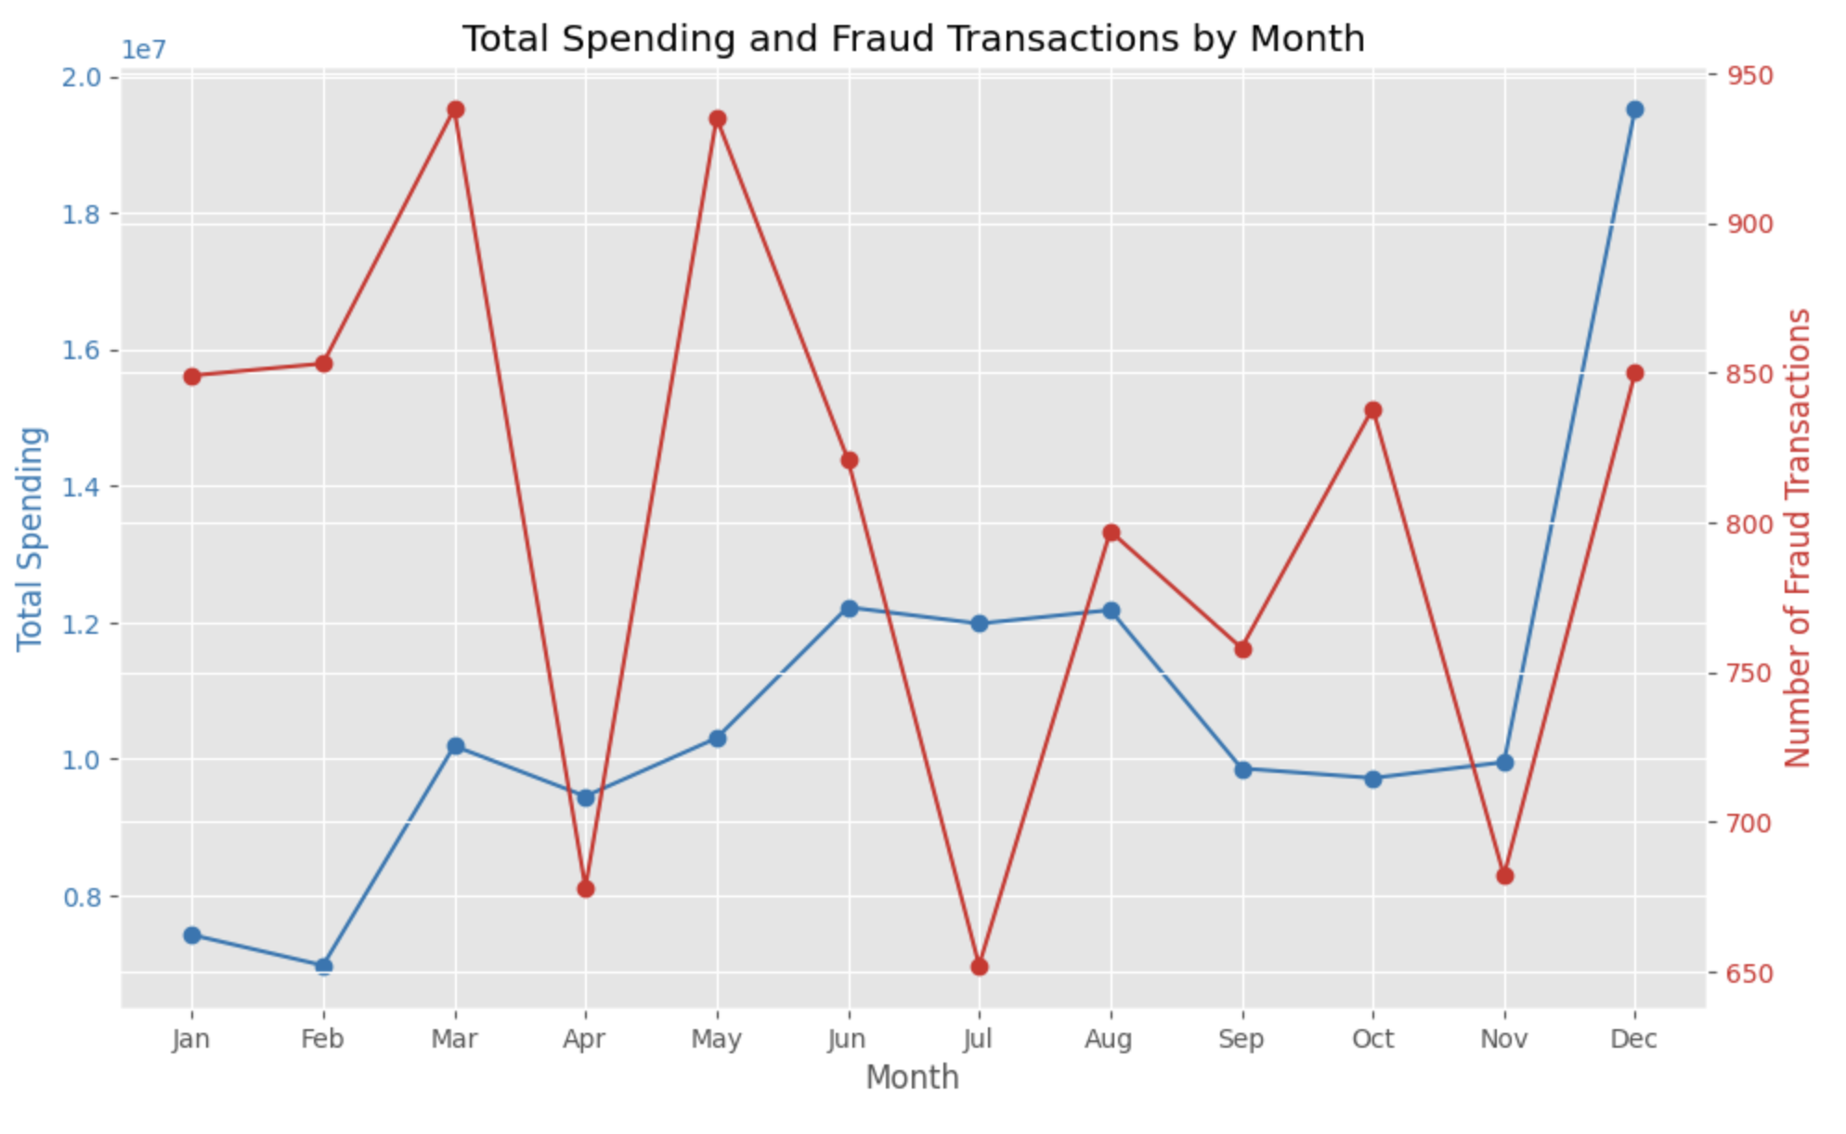
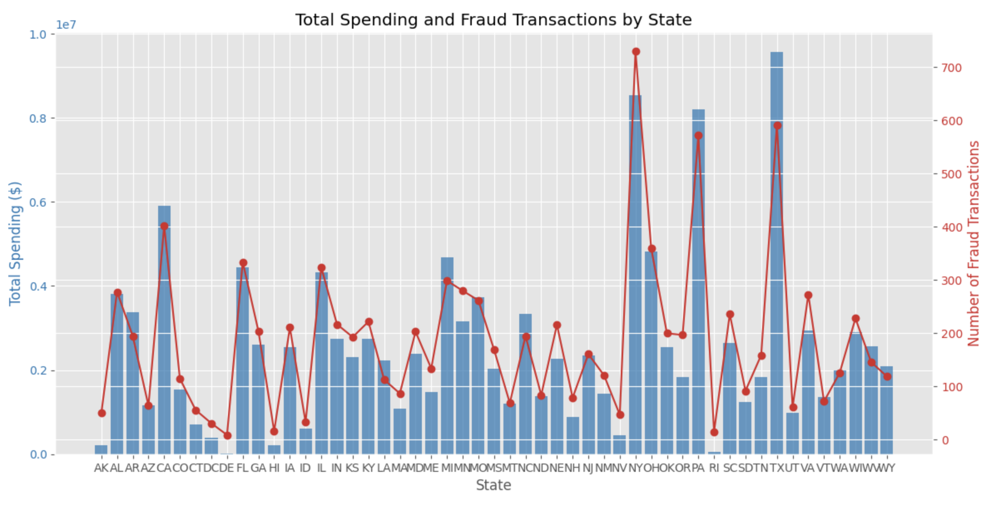
Preliminary Analysis

Slide 8
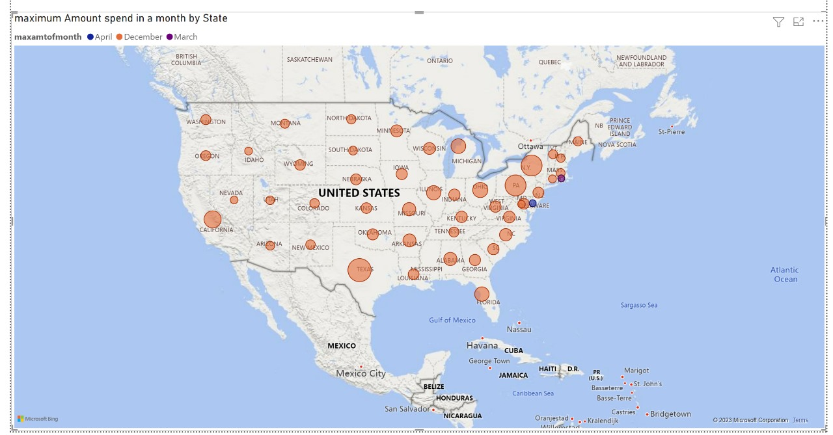
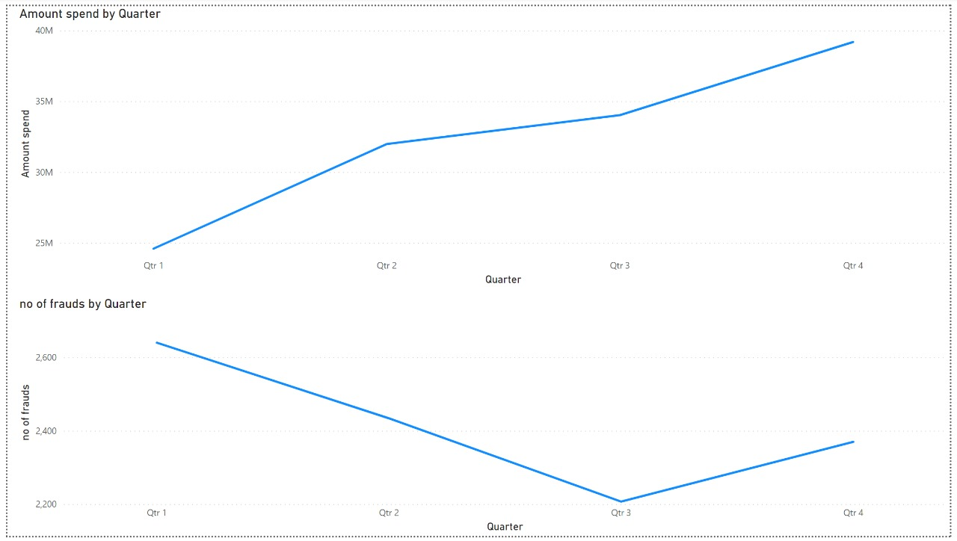
Preliminary Analysis

Slide 9
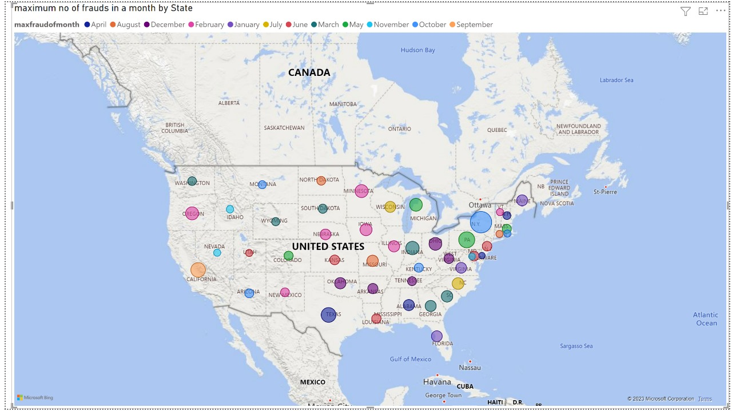
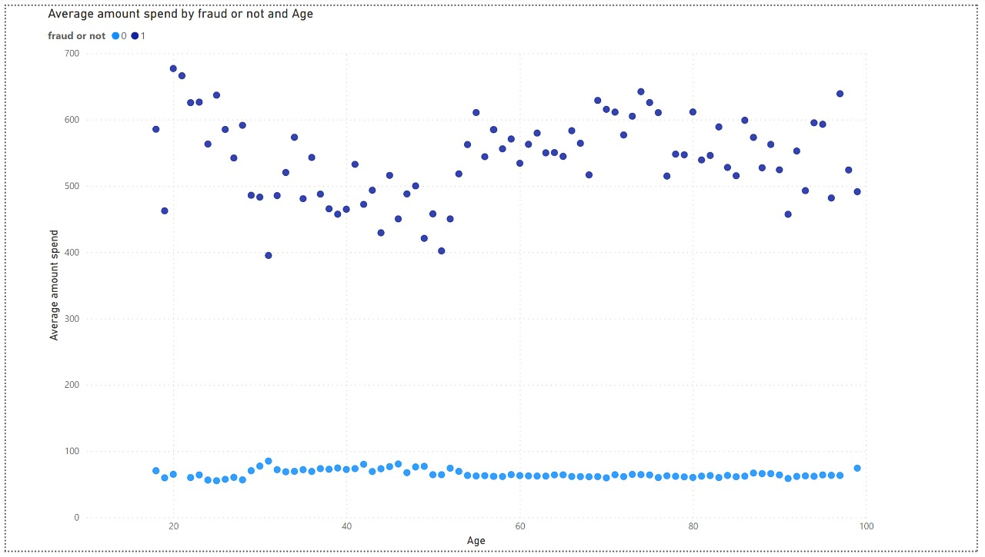
Preliminary Analysis

Slide 10
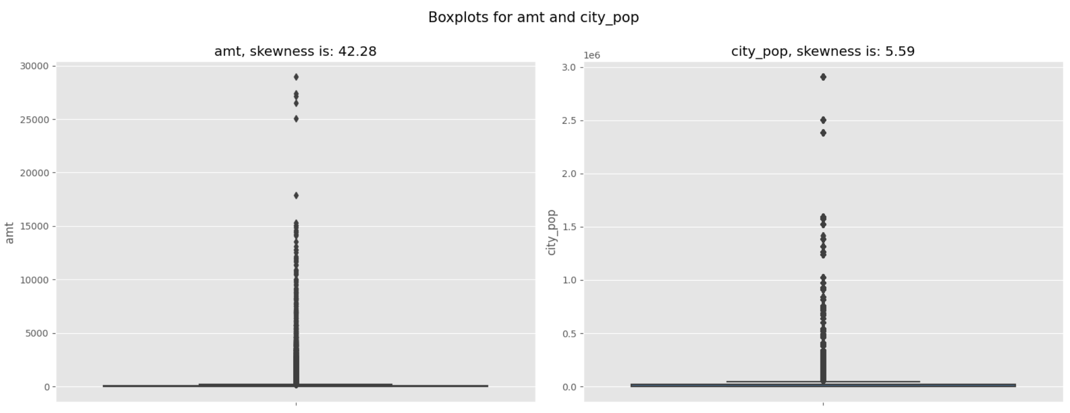
Preliminary Analysis
The dataset is strongly skewed to the right, as shown by a skewness score of 42.8, and it is possible that there are large values that are having a substantial impact on the distribution.
According to the above bar plot, the amount involved is high for the majority of fraudulent transactions.
Removal of outliers is not appropriate in this situation since they represent the highest risk of fraud.

Slide 11
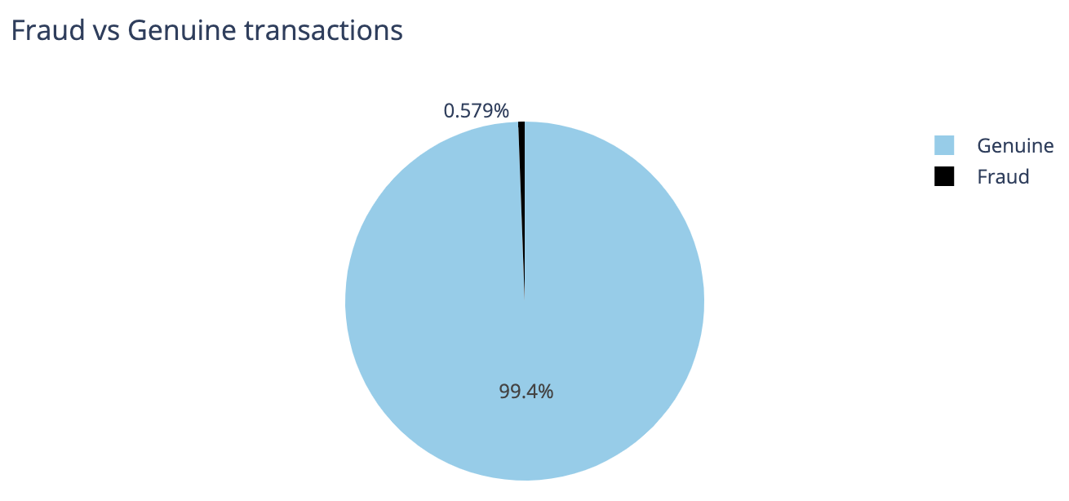
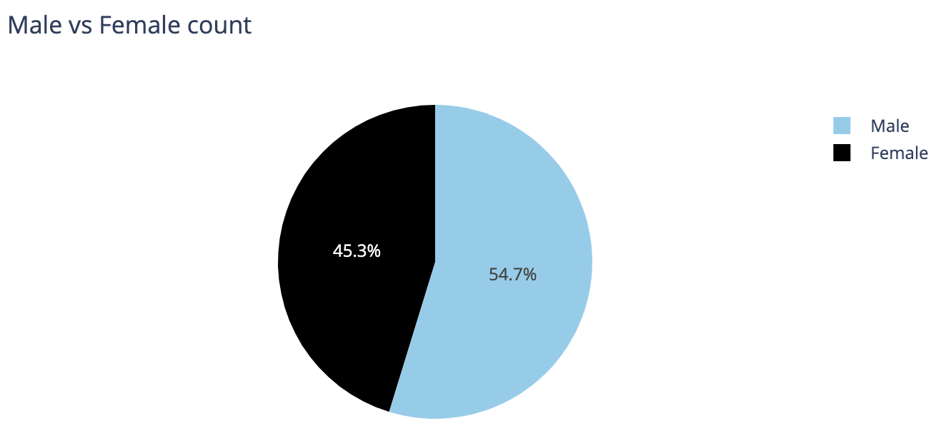
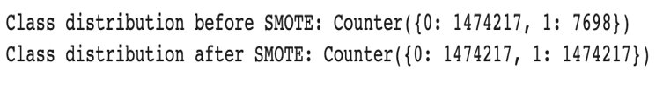
Class Imbalances & Treatment Techniques
We can't use accuracy score as a metric with imbalanced datasets - it will be usually high and misleading. In this dataset, we have 99.4% of Genuine transactions and only 0.579% (579) of fraud transactions; which means that a blind guess (bet on Genuine) would give us accuracy of 99.4%.
Few techniques to avoid data and class imbalances were:
Under Sampling
Over Sampling
SMOTE(Synthetic Minority Over-sampling Technique)
Adasyn

Slide 12
Methodologies
Recurrent Neural Networks (RNNs):
RNNs, such as LSTM (Long Short-Term Memory) or GRU (Gated Recurrent Unit), are well-suited for sequential data like time series.
We can use RNNs to model the temporal dependencies in your dataset, which can be important for detecting fraud patterns over time.
Autoencoders:
Autoencoders are neural networks used for dimensionality reduction and feature learning. They can help in identifying unusual patterns in the data.
We can build an autoencoder to reconstruct the input data and then use the reconstruction error as an anomaly score for fraud detection.
Deep Neural Networks (DNNs):
Traditional feedforward neural networks (DNNs) can also be effective for tabular data.
We can create a deep neural network architecture with multiple layers and employ techniques like dropout to prevent overfitting.

Slide 13
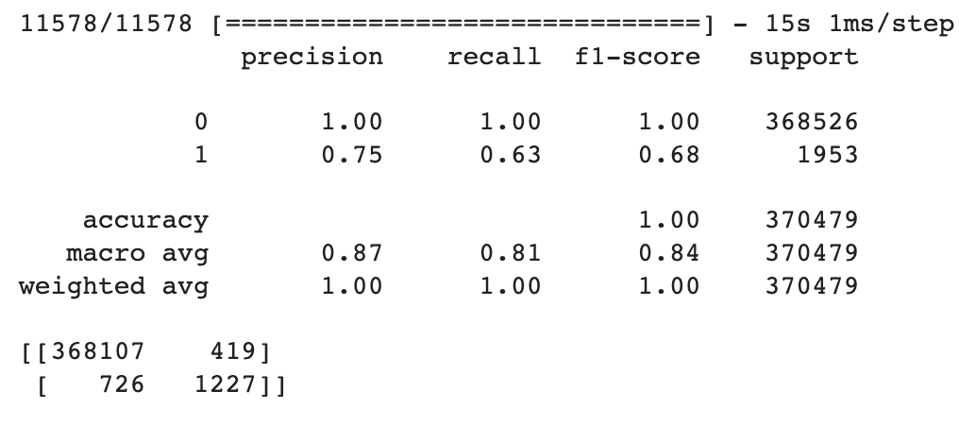
Model Implementations
Sequential Model
Dense Layer (64 units): It is a fully connected (dense) layer with 64 units and ReLU activation, Dense Layer (32 units): Another fully connected layer with 32 units and ReLU activation, Dense Layer (1 unit): The output layer with a single unit and sigmoid activation.
This is a binary classification model, and the sigmoid activation function is often used for binary classification tasks.
After defining the model, you compile it using the Adam optimizer, binary cross-entropy loss (commonly used for binary classification problems), and accuracy as the metric for evaluation.

Slide 14
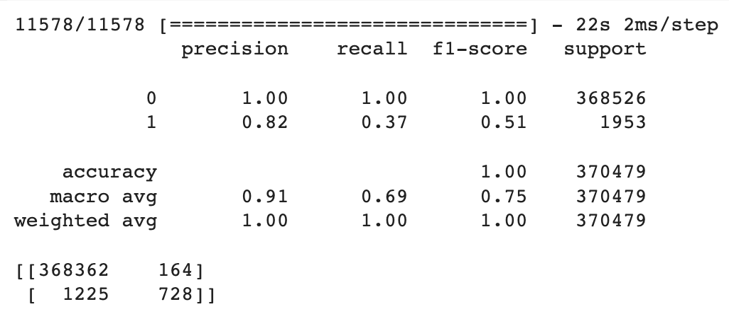
Convolutional Neural Network (CNN)
This is a sequential model for a 1D Convolutional Neural Network (CNN) designed for some form of sequence data (possibly time-series data). It consists of the following layers:
Conv1D Layer (64 filters, kernel size 3): This layer performs a 1D convolution operation with 64 filters and a kernel size of 3. It uses ReLU activation. MaxPooling1D Layer (pool size 2): After the convolution, there's a max-pooling layer with a pool size of 2, Conv1D Layer (128 filters, kernel size 3): Another convolutional layer with 128 filters and kernel size 3, also using ReLU activation.
MaxPooling1D Layer (pool size 2): Another max-pooling layer with a pool size of 2. Flatten Layer: This layer flattens the output from the previous layers into a 1D vector, preparing it for the fully connected layers. Dense Layer (64 units): A fully connected layer with 64 units and ReLU activation.
Dropout Layer: A dropout layer with a dropout rate of 0.5, which helps prevent overfitting. Dense Layer (1 unit): The output layer with a single unit and sigmoid activation, indicating binary classification.
The model is compiled using the Adam optimizer, binary cross-entropy loss, and accuracy as the metric, just like the first model. In summary, the first model is a feedforward neural network, while the second model is a 1D convolutional neural network, typically used for sequence or time-series data. Both models are designed for binary classification tasks

Slide 15
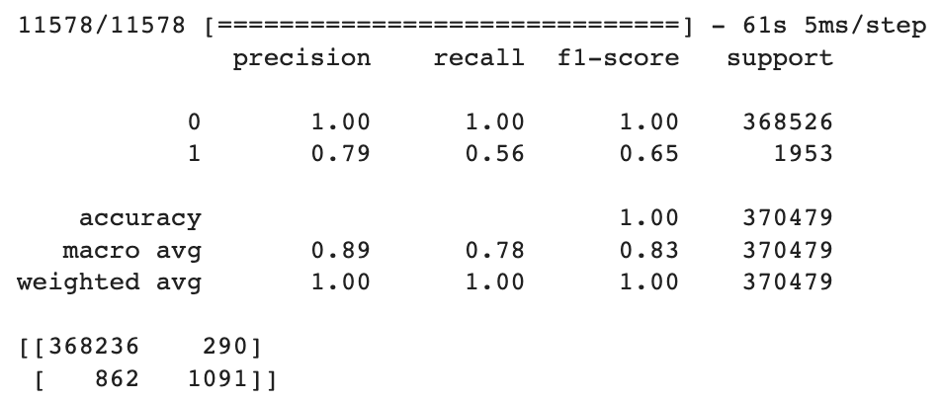
Long Short-Term Memory Model
LSTM is a type of recurrent neural network (RNN) architecture, specifically designed to handle and capture long-range dependencies and temporal patterns in sequential data. LSTMs are often used in tasks such as time series analysis, natural language processing, and any task where the order of data points is significant.

Slide 16
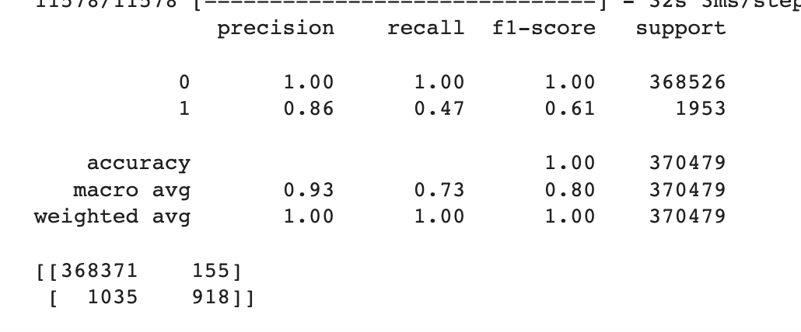
GRU Model
A GRU is a type of recurrent neural network (RNN) that is designed to capture and model sequential data. It is similar to the more complex LSTM (Long Short-Term Memory) but is computationally more efficient and can be easier to train.

Slide 17
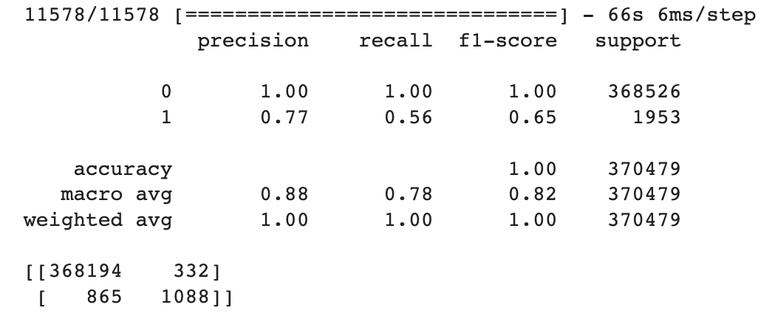
Auto encoder model
An autoencoder is a type of neural network used for dimensionality reduction, feature learning, and anomaly detection. It consists of an encoder network that maps the input data to a lower-dimensional representation and a decoder network that attempts to reconstruct the original input from this representation.

Slide 18
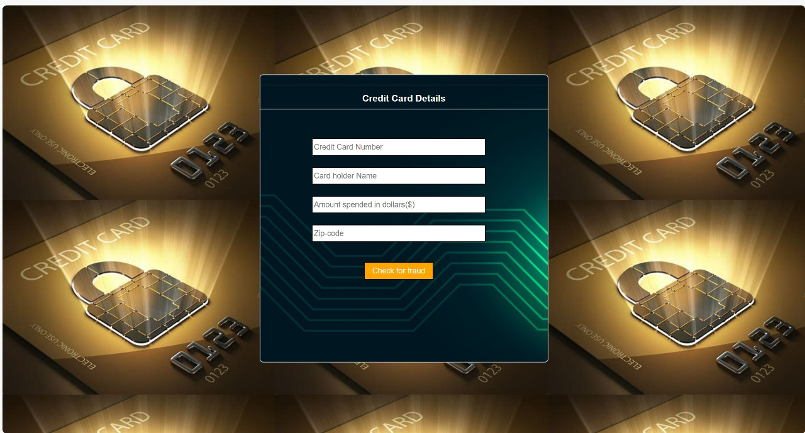
Webpage

Slide 19
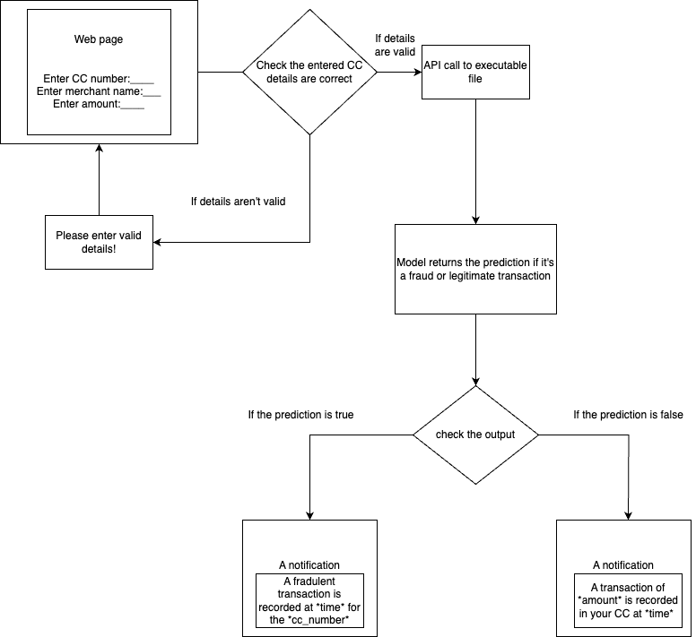
Conceptual Diagram

Slide 20



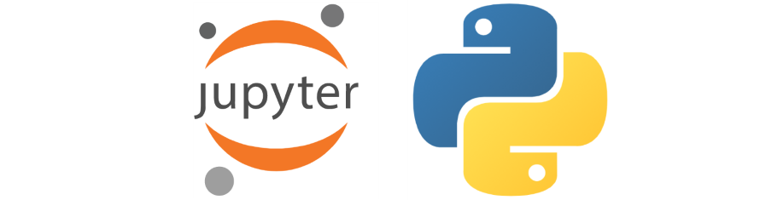

Architecture
Output
Modelling

Slide 21
Timelines and Roadmap
Model Optimizations: October
Data Finalization , Model Finetuning, optimizations : November
Documentation, Visualizations and Final Presentation : December

Slide 22
Q & A

